Slide 1
DXC REAL-TIME PROJECTS
PRESENTED BY:
NAGA ISWARYA LAKSHMI BHOGADI
DXC262AB1205

Slide 2
PROJECTS ASSIGNED
PROJECT 1 : CONNECTED VEHICLES
PROJECT 2 : AP MORGAN DATA PLATFORM

Slide 3
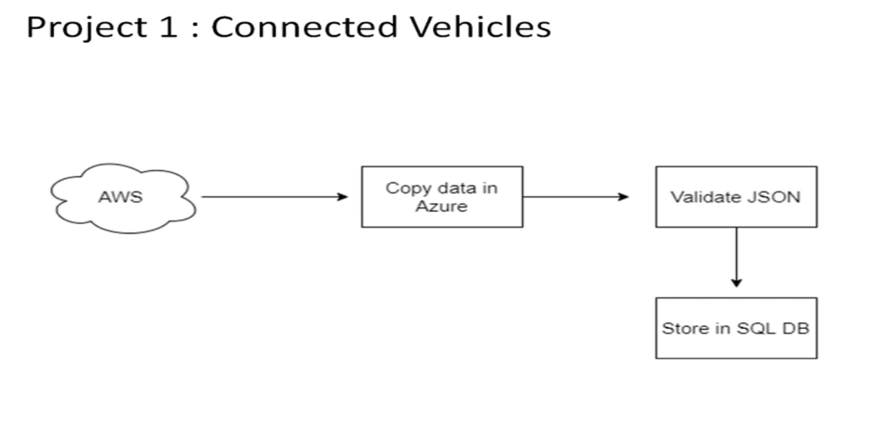
PROJECT 1 : CONNECTED VEHICLES
Moving data from AWS to SQL DB using pipelines

Slide 4
STEPS TO BE PERFORMED
Creating azure data factory
Creating Azure data factory pipeline
Creating blob trigger logic
Creating azure sql server and database
Adding another pipeline to move data from staging to sql database

Slide 5
RESOURCES
Azure Storage Account
Azure Data Factory
Azure SQL Database

Slide 6
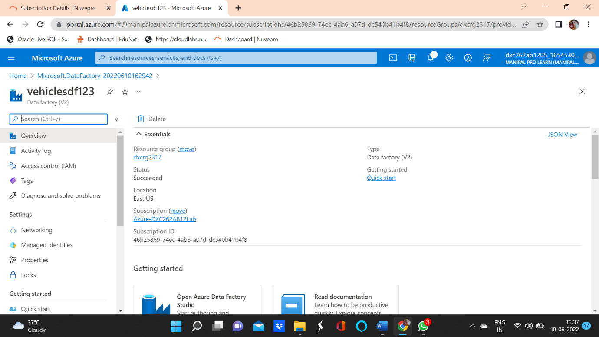
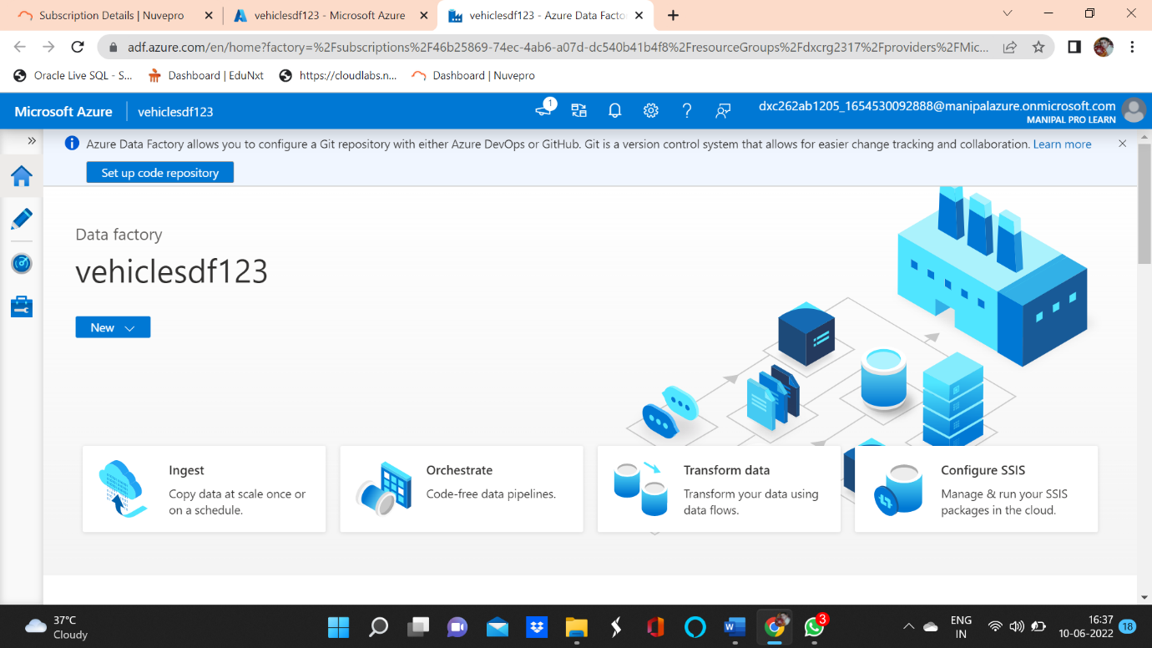
CREATE AZURE DATA FACTORY ACCOUNT
Create and launch Azure Data Factory

Slide 7
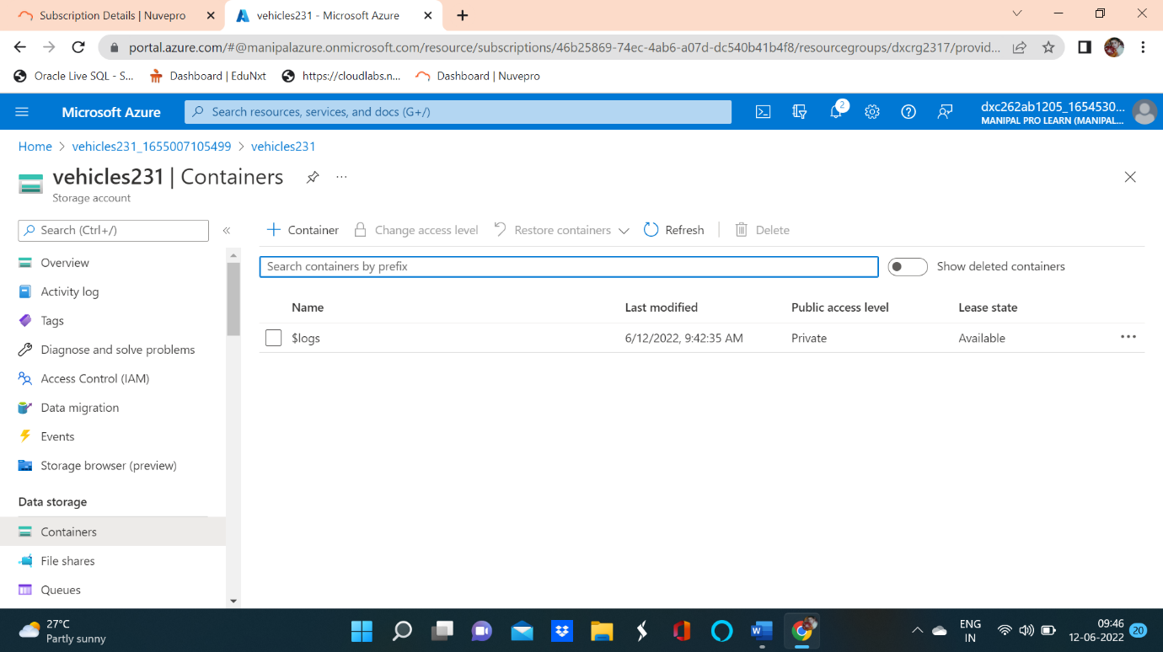
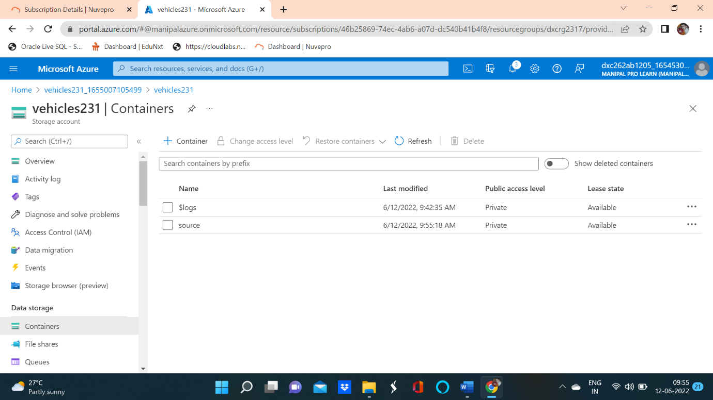
AZURE STORAGE ACCOUNT
Create an azure storage account and then create source and destination containers.

Slide 8
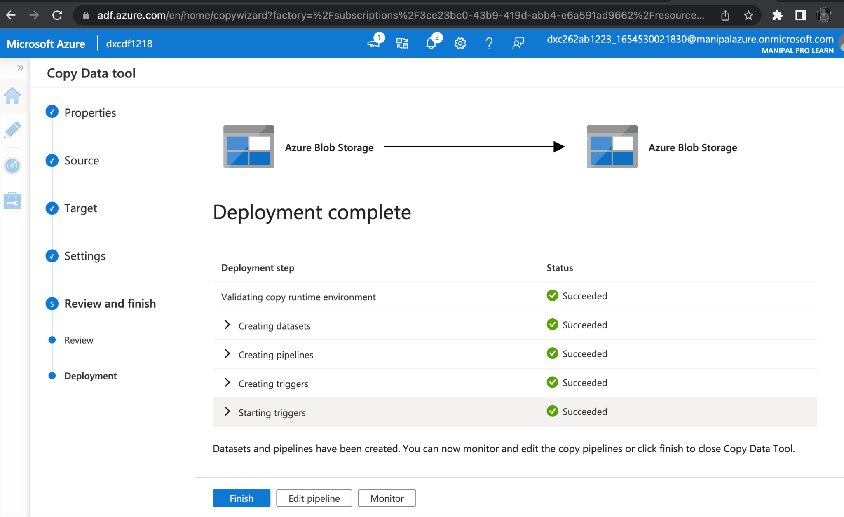
CREATE AZURE DATA FACTORY PIPELINE
A pipeline is a logical grouping of activities that together perform a task.

Slide 9
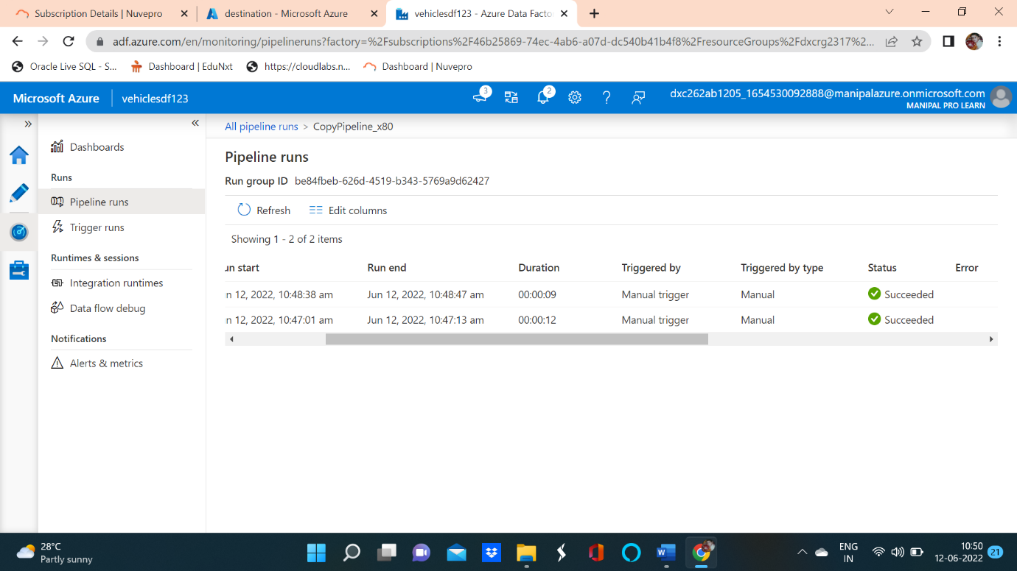
CREATING BLOB TRIGGER
CREATION OF BLOB TRIGGER SUCCESSFUL

Slide 10
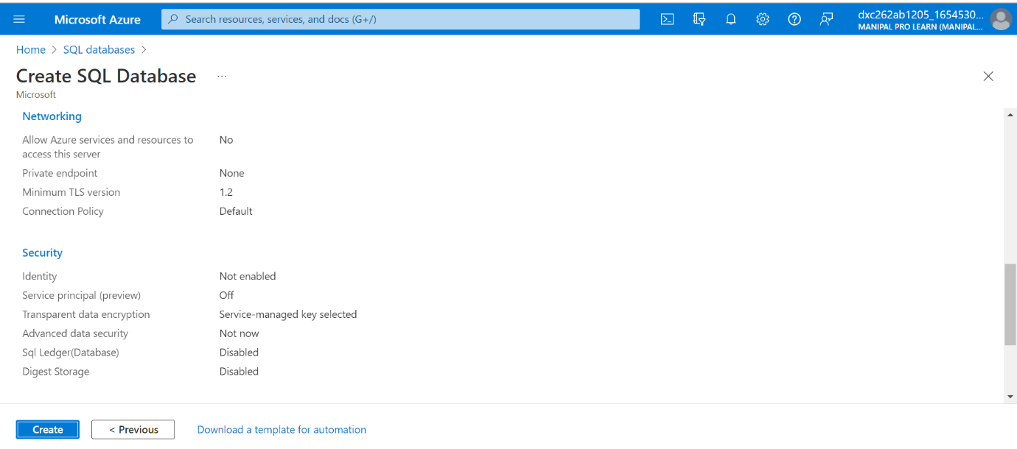
AZURE SQL DATABASE
Create Azure SQL Server and Database

Slide 11
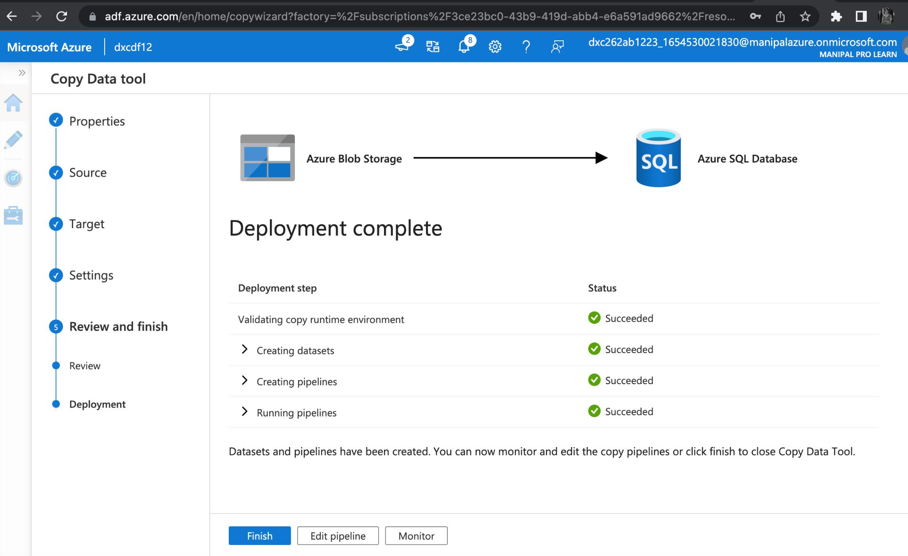
Adding another pipeline to move data from staging to SQL Database
PIPELINE ADDED SUCCESSFUL

Slide 12
CONCLUSION
In this project by using azure data factory, we create a pipeline that will validate and copy the blob data into the SQL database.

Slide 13
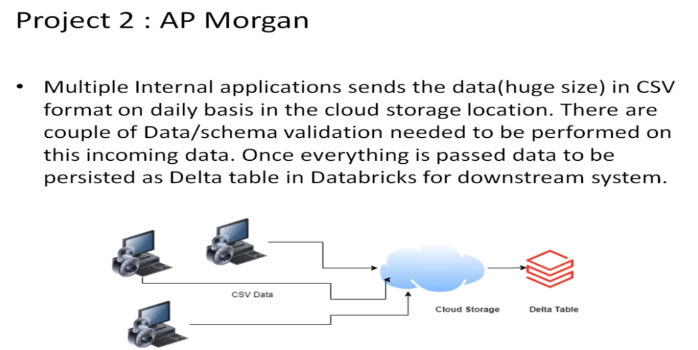
PROJECT 2 : AP MORGAN DATA PLATFORM
Azure Data Bricks Linked service in Azure Data Factory

Slide 14
STEPS TO BE PERFORMED
Create data bricks
Creating the cluster in data bricks
Adding notebook in databricks and Implement BI
Creating data factory
Creating azure data bricks linked service in azure data factory

Slide 15
RESOURCES
Azure Data Factory
Azure Data Bricks

Slide 16
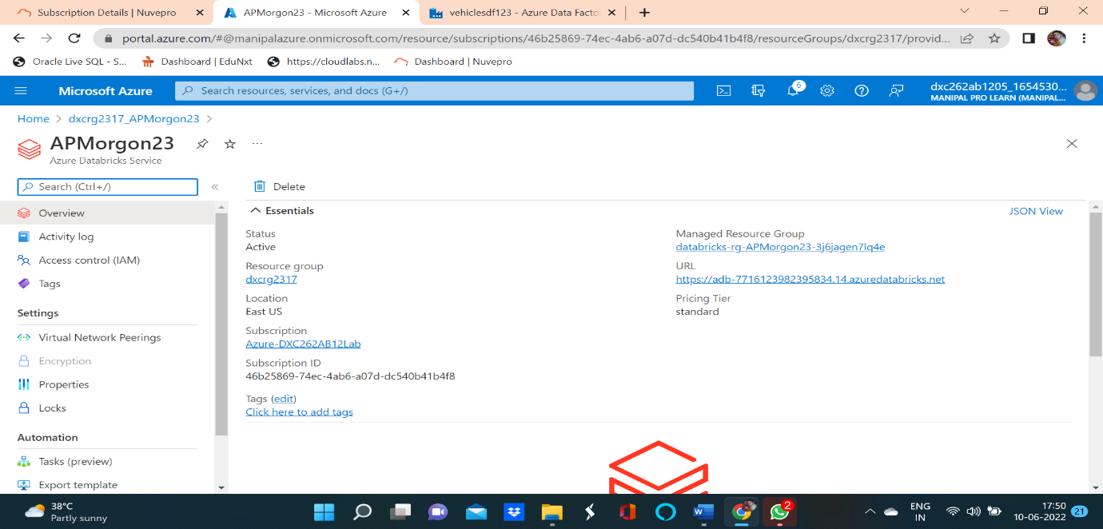
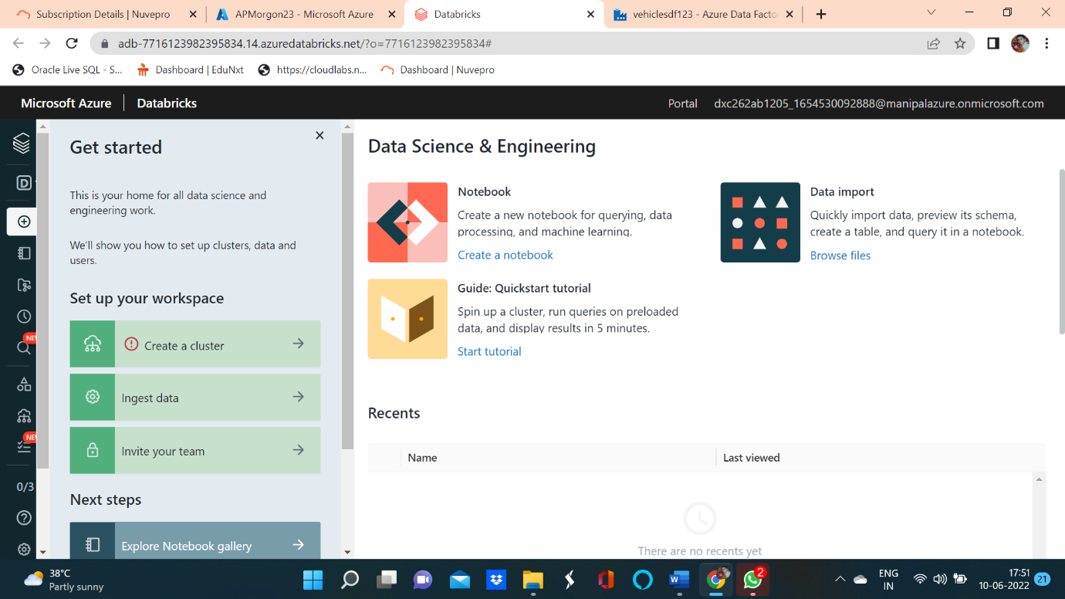
CREATE AZURE DATA BRICKS
Create Azure DataBricks account and launch workspace.

Slide 17
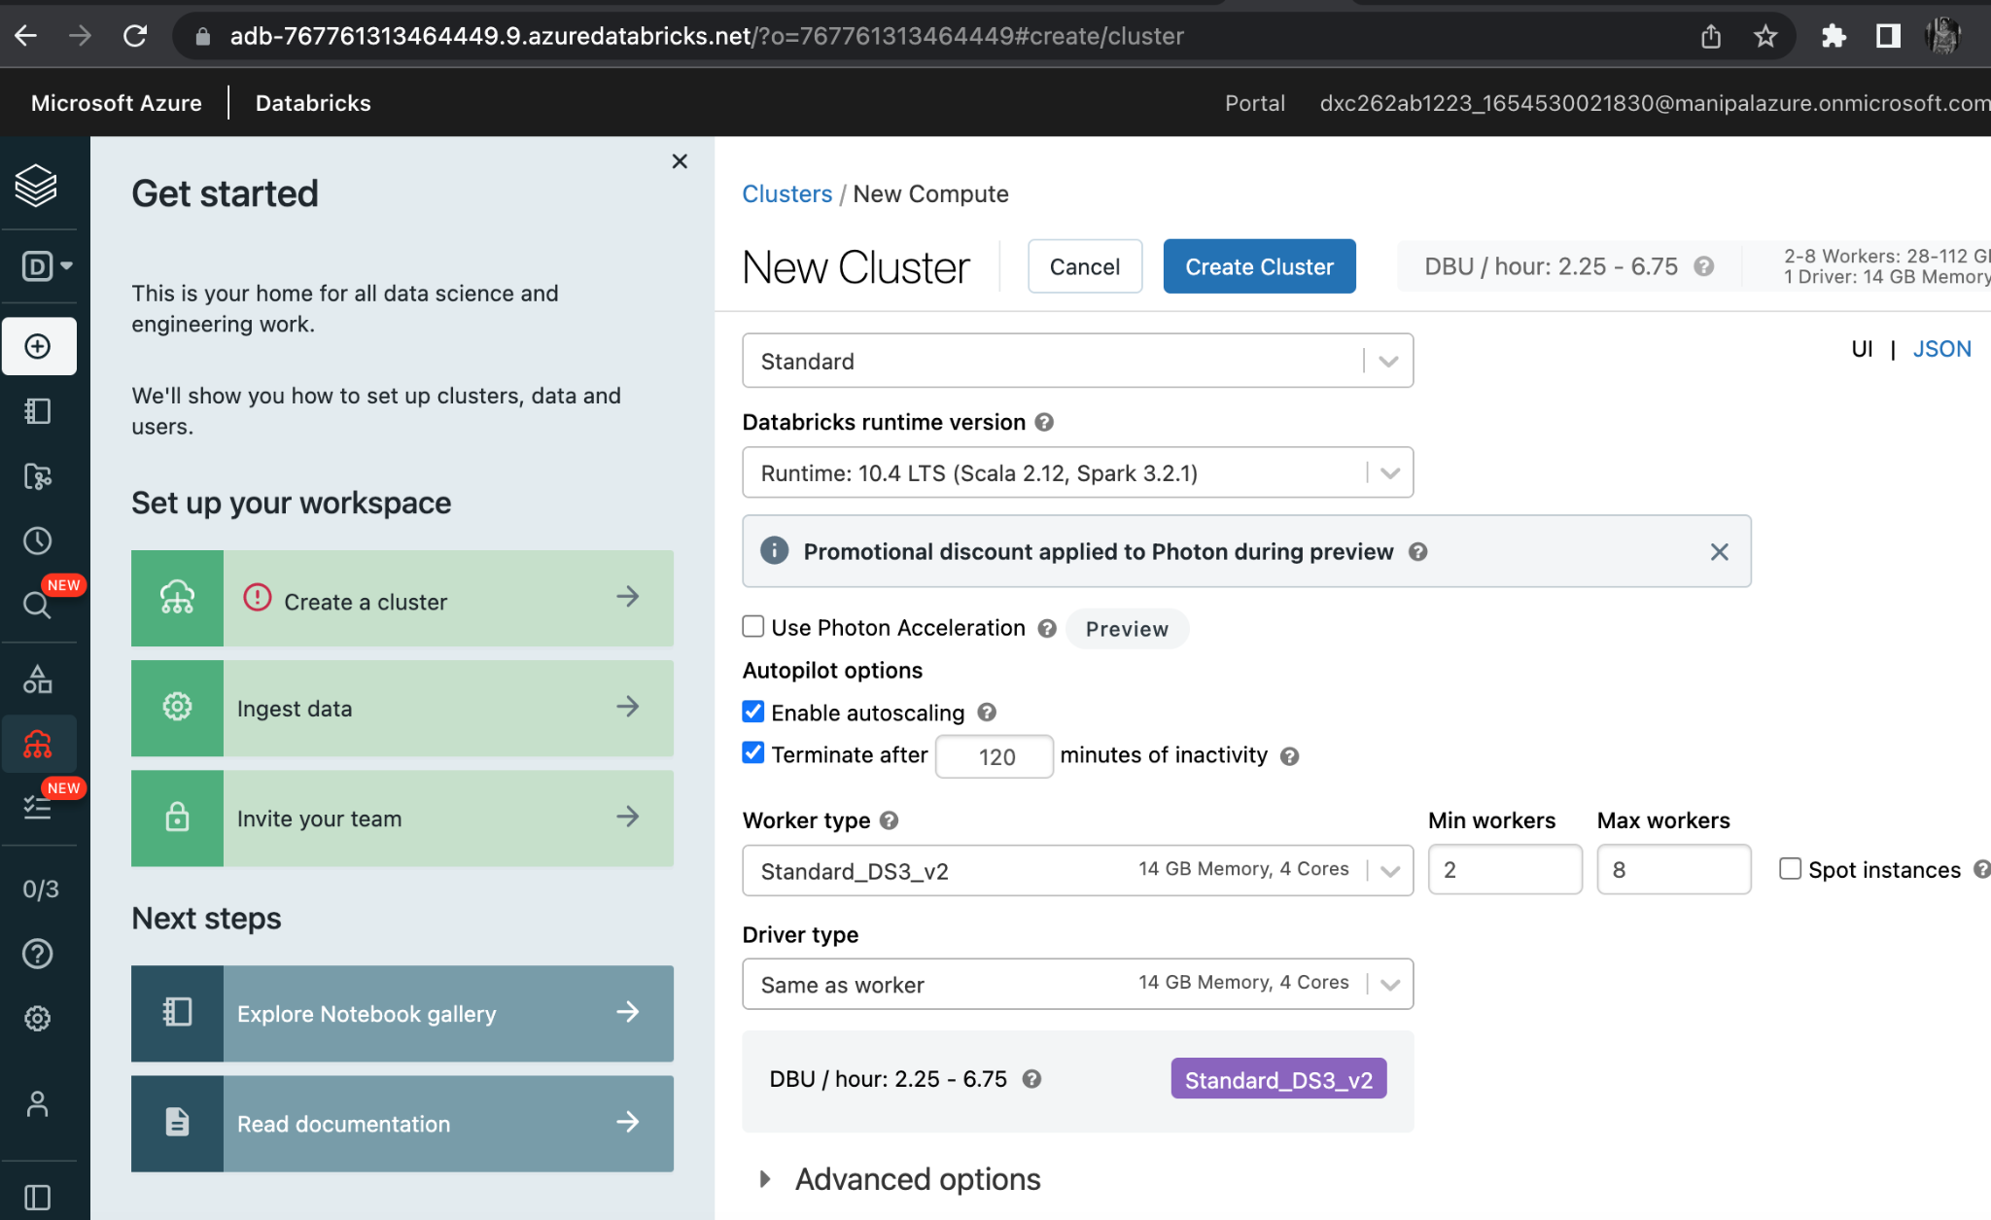
CREATING A CLUSTER IN THE DATABRICKS
CLUSTER CREATED

Slide 18
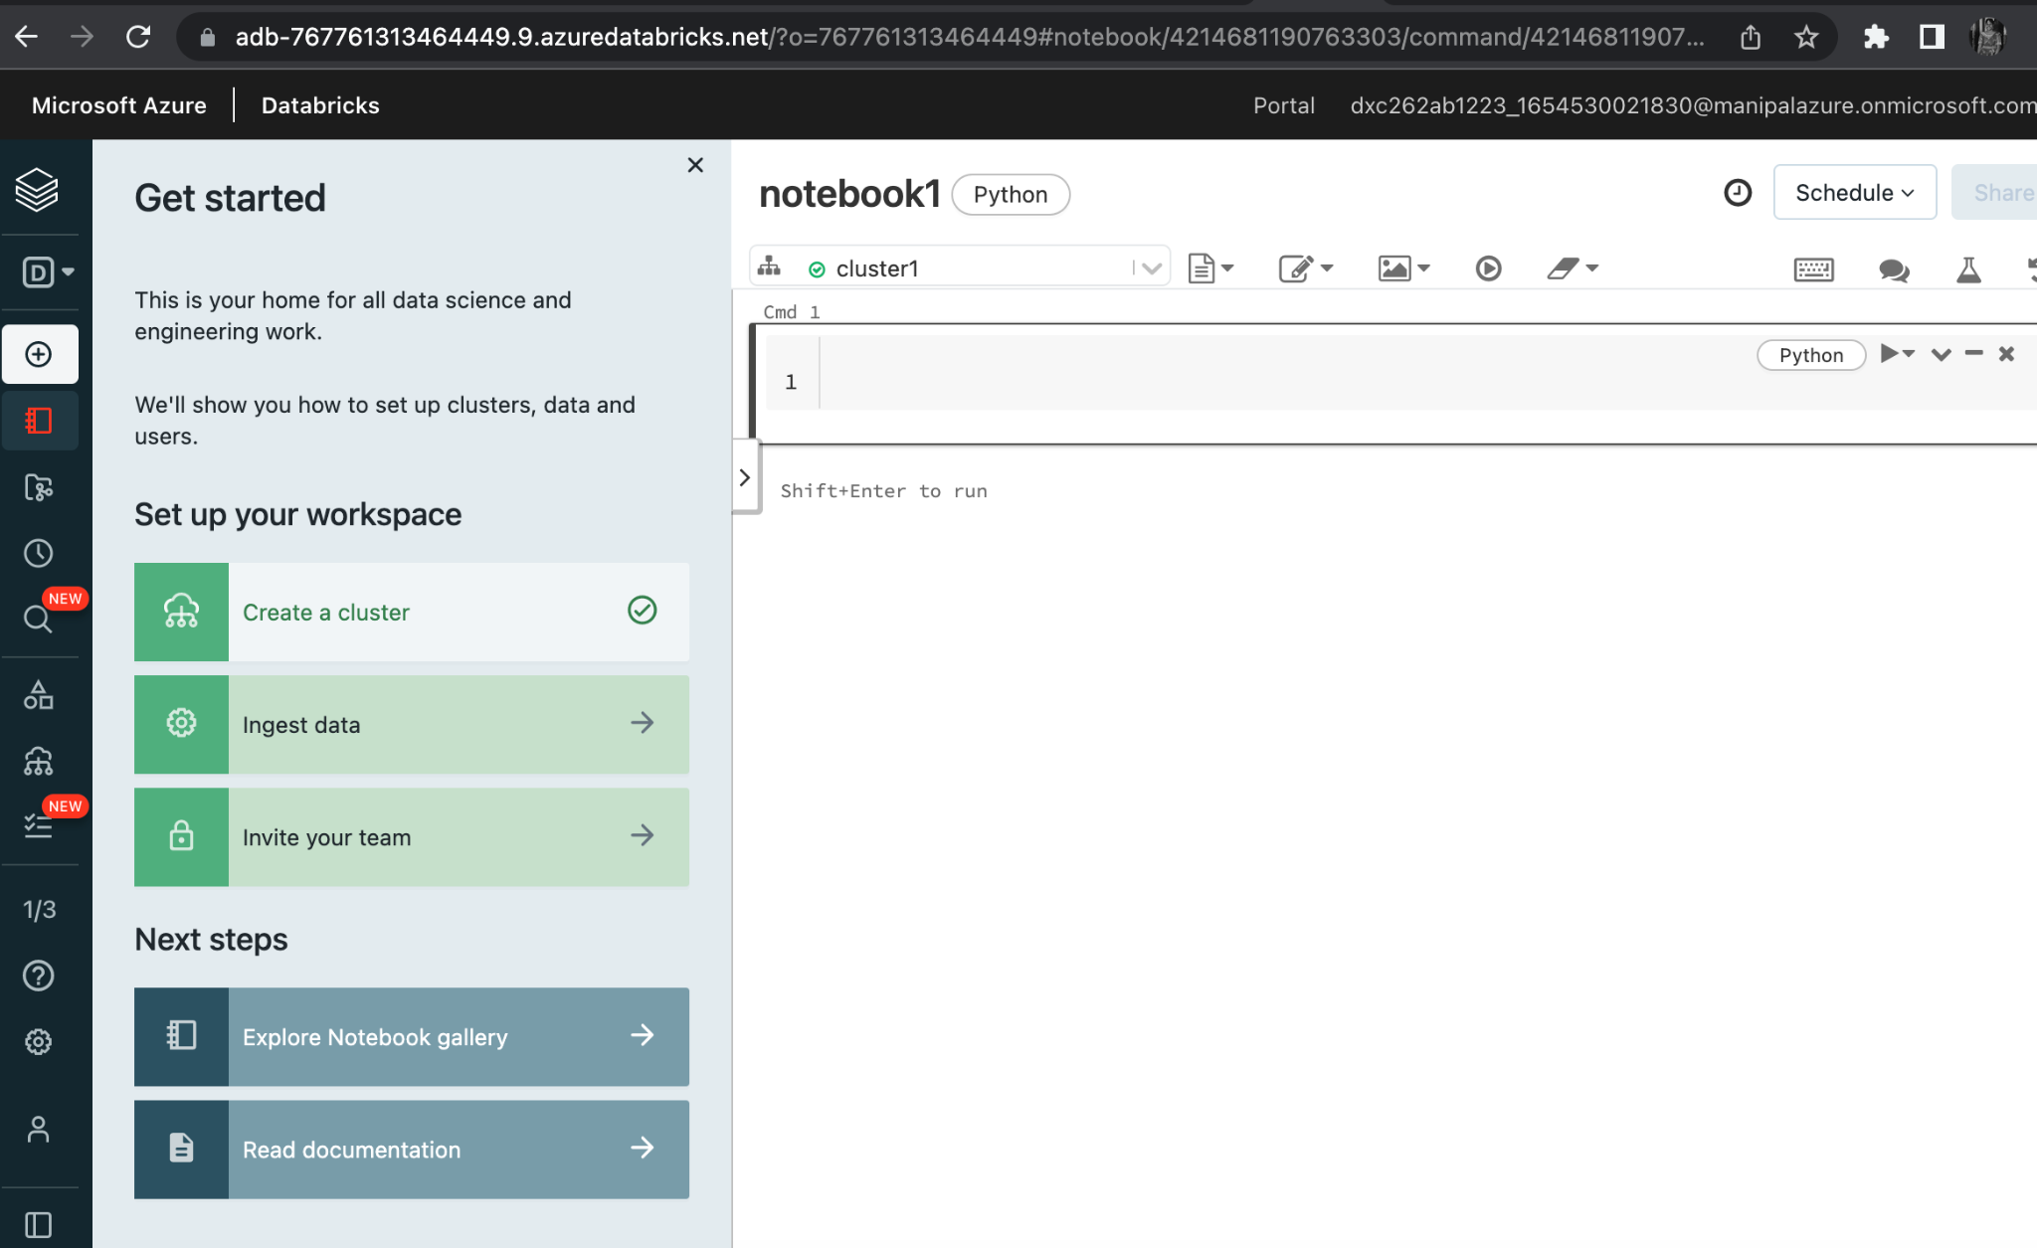
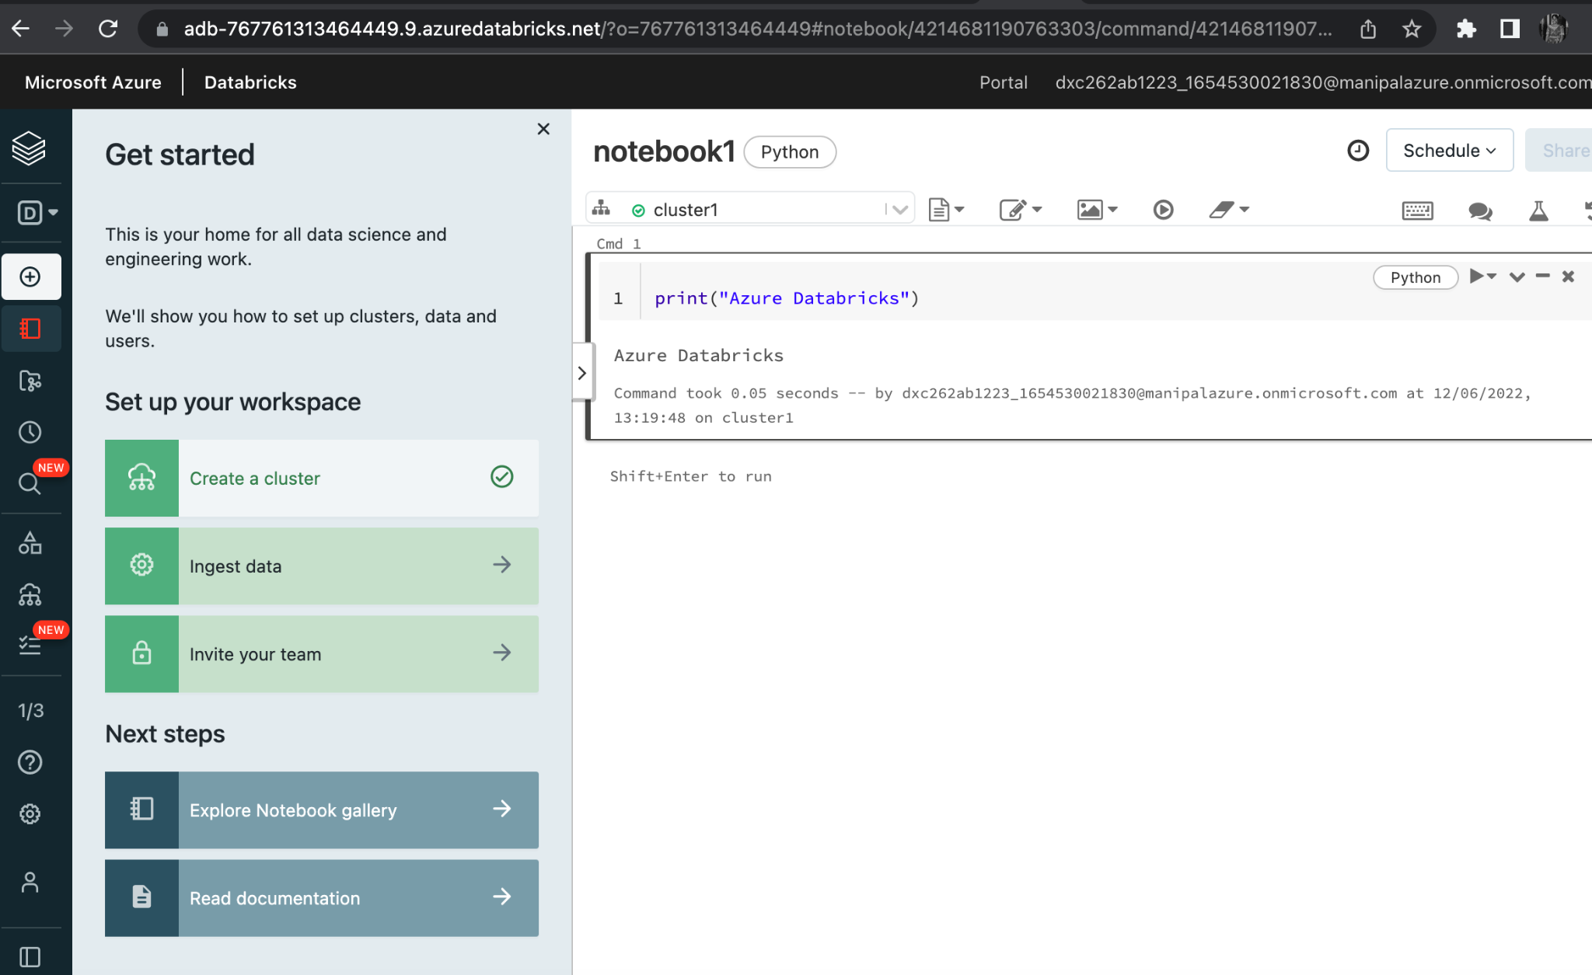
ADDING NOTEBOOK IN THE CLUSTER
NOTEBOOK CREATED AND BI IMPLEMENTED.

Slide 19
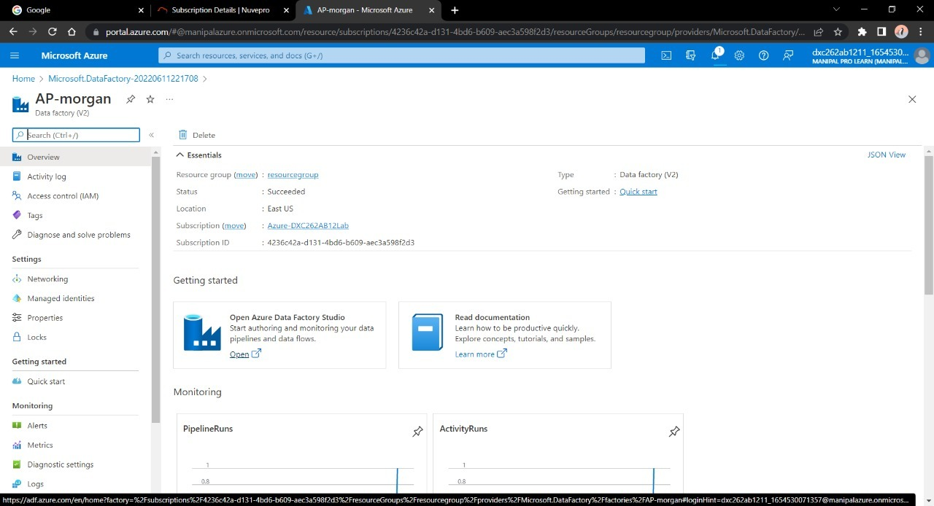
CREATE AZURE DATA FACTORY
DATA FACTORY CREATED.

Slide 20
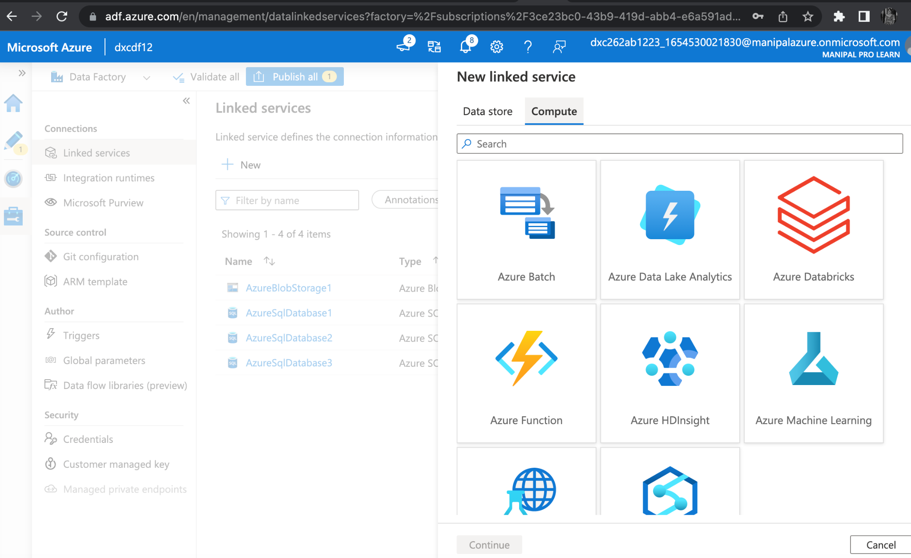
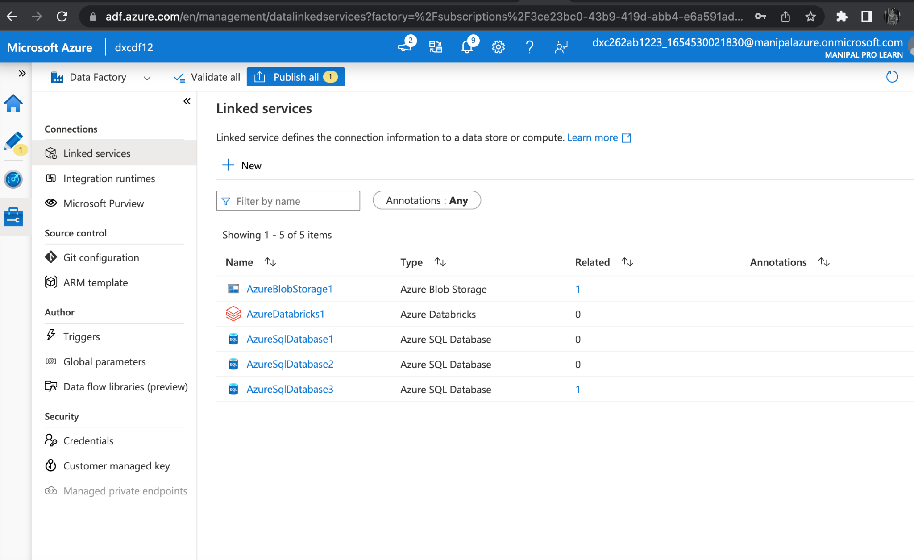
Azure Databricks Linked Service in ADF
Now we need to link data factory and azure data bricks by using linked services. We need to generate access token to link the services.

Slide 21
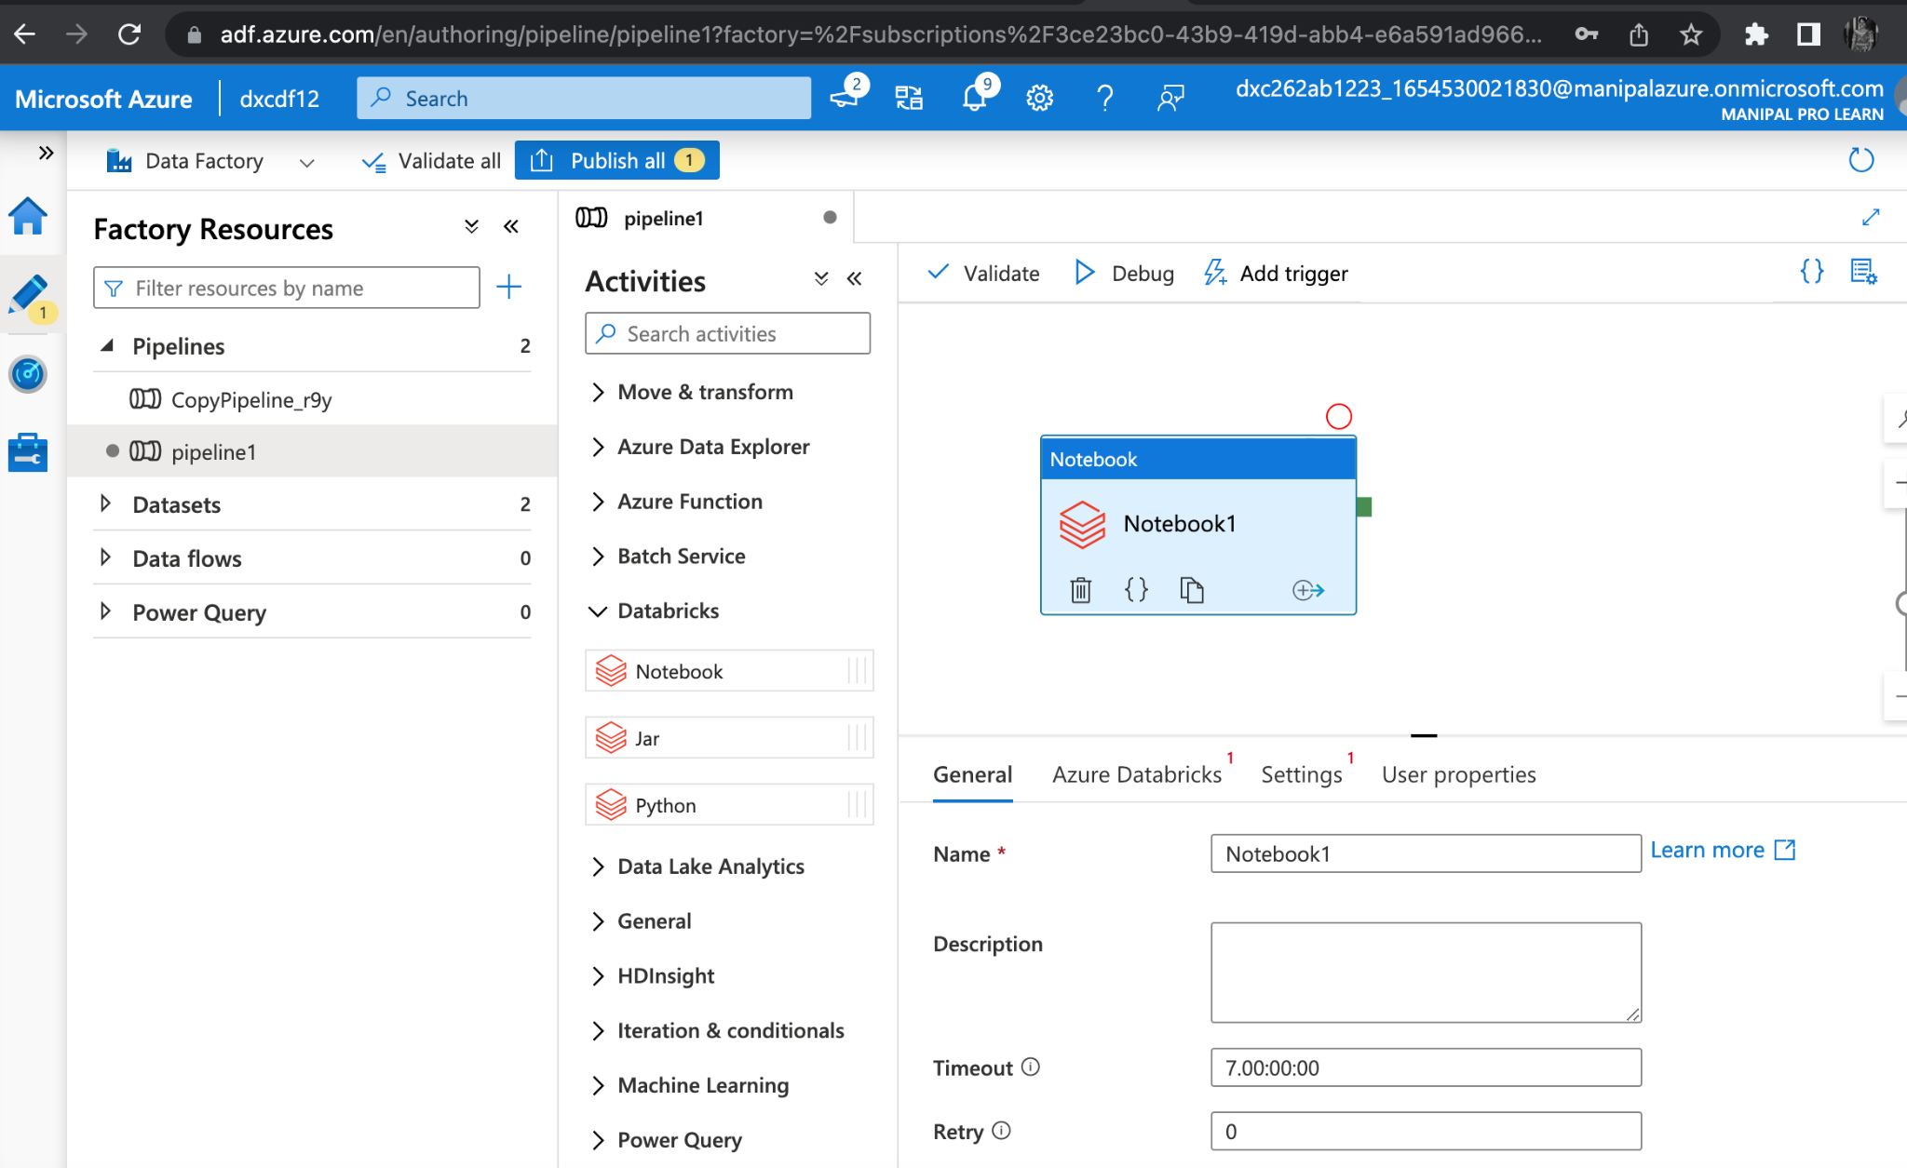
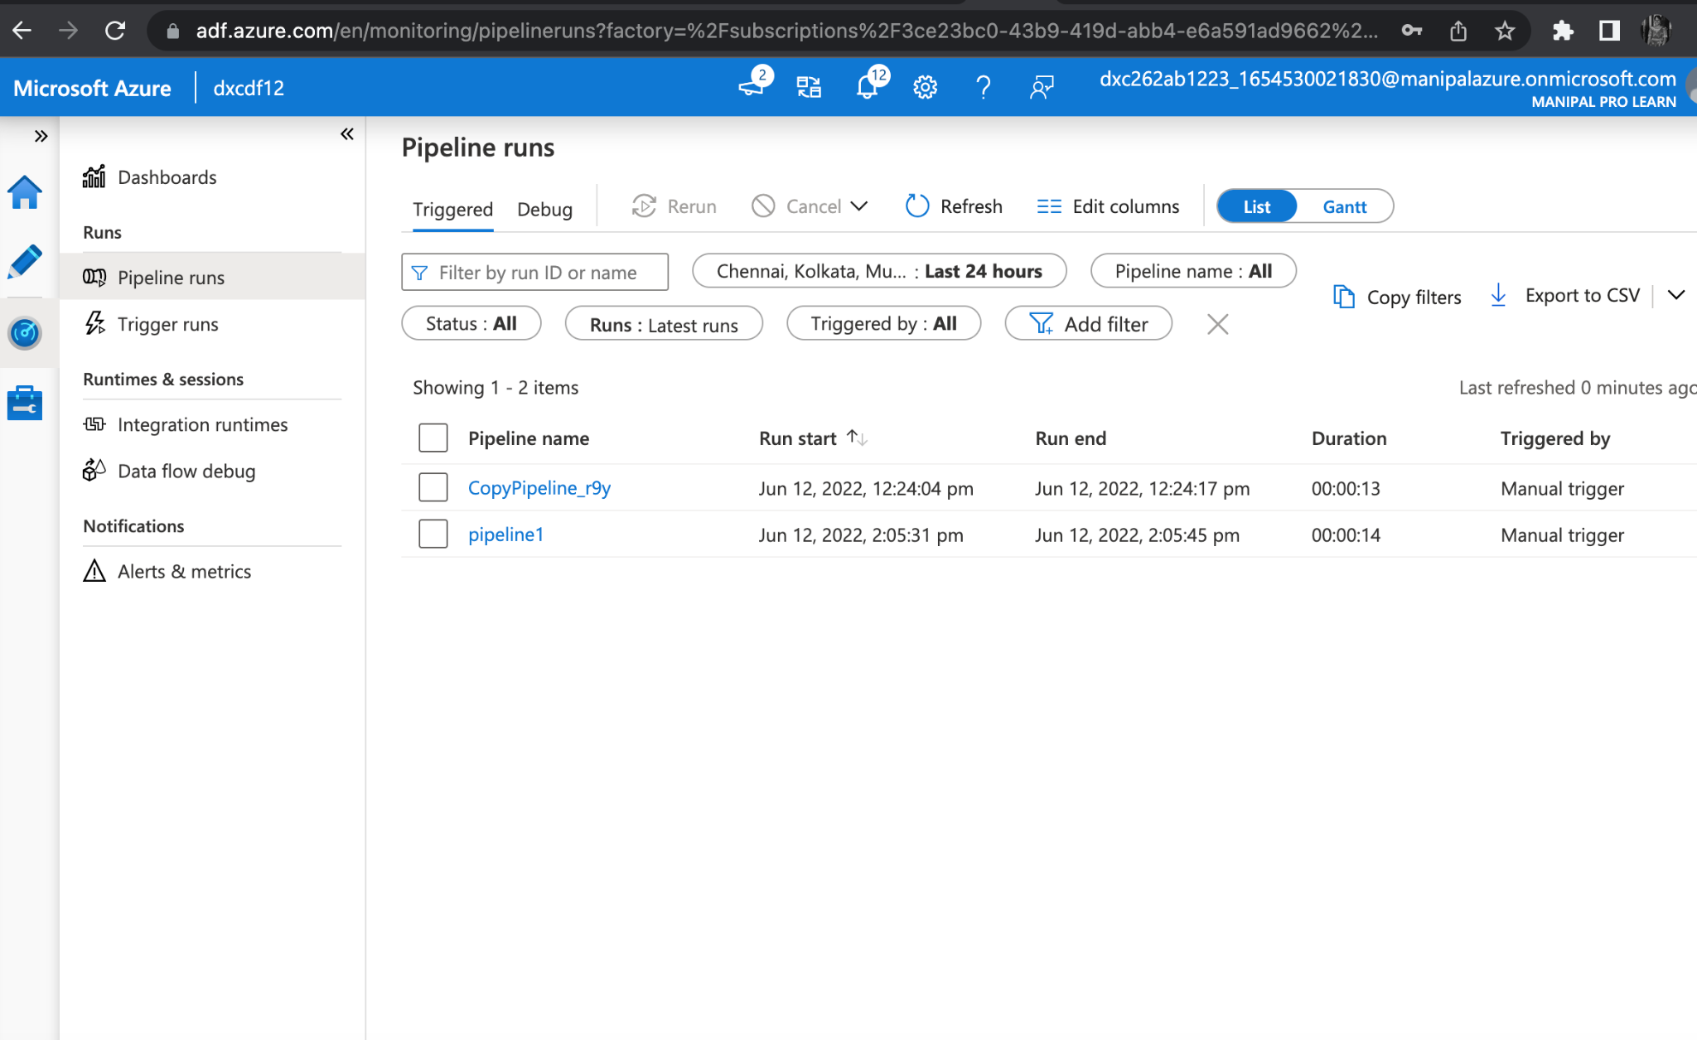
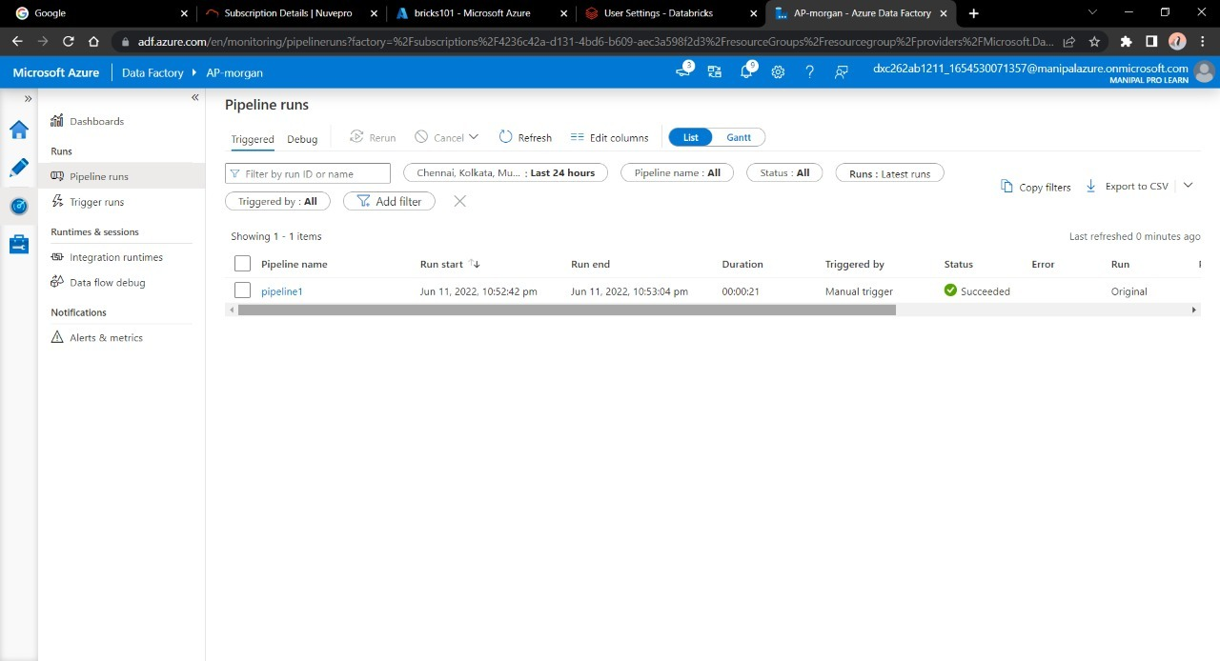
Azure Databricks Linked Service in ADF
Create a pipeline by draging the notebook tab from the azure databricks drop down onto the workspace of the pipeline.
Publish the pipeline and then we can trigger and run the pipeline

Slide 22
CONCLUSION
Using Data Factory, We were successfully link and trigger an azure data bricks notebook and both Azure Data Factory and Data Bricks are related.

